Slide 1
/HOW THE HECK DO I BUILD A VIDEO GAME?!
TL2 Presentation
Jacob Wobido, Carson Sloan,
Spencer Butler, Savannah Johnson
INDEX.HTML

Slide 2
Glossary: "What the heck is an Asset, actually?"
Asset
Scene
GameObject
Component
Tag
Prefab
Any item in a Game or Project. (Really, any item at all! Everything here is an asset, too!) Can contain, inherit, and communicate with other assets.
Contains all or part of the app or game. Think of it like a directory—it can contain different kinds of data, and all objects can talk to each other.
Can be many things: a Sprite, a Camera, etc. Essentially a container for components. Think of it like a class—they can contain vars, functions, and have inheritance.
Essentially a script. Can be attached to any Game Object to give it properties or behavior. You can add any number of extra components to any kind of Game Object.
A custom reference you can assign to any Game Object, and acts like a label. Lets you access a group of Game Objects that share the tag.
A template for a Game Object, saving all the originals configurations and components. Retains all functionality of a Game Object and can be reused as-is or edited.

Slide 3
Glossary: "No, seriously, what even is a Canvas?"
UI
Canvas
Panel
EventSystem
Ordering Layer
Camera
Useful Game Objects with components that lets a user interact with the application. Buttons, text entries, scrollers, etc.
Similar to a Scene, but specifically holds all UI Game Objects. ALL UI Game Objects must be the child of a Canvas! You can have any number of Canvases.
Game Object that groups similar UI elements together. If a Canvas is a root directory, then a Panel is a bit like a sub-directory.
VITAL object for UI, is auto-generated when a Canvas is created. Sends events to objects based on user input. Allows a button to be pressed, or a scroller to scroll.
A visual property that all Game Objects have. Determines what items render in what order. Make a screen visible by changing its Layer to the top of the stack!
A player's view into the game. Could contain the entire game, or let a player only see a bit at a time. Can be static and stuck to the scene or move with the player.

Slide 4
1. Player
"How will the user interact with my game?"

Slide 5
Things We'll Cover:
Setting up a project
Adding a "Render Pipeline"
Making a player prefab
Setting up and using the "Input Manager"
Adding physics to our character and environment
Adding animations

Slide 6
Unity Render Pipelines:
Scriptable RP
Universal RP
High Definition RP
- Built in
- Ability to write SubSurface shaders
- Faster with extremely lightweight projects
- Download required
- Shader Graph support
- VFX Graph support
- Better performance
- Post-Processing
- Additional features
- Download required
- Everything in URP
- Realtime point
light shadows
- Raytracing
- Volumetrics support

Slide 7
Smoothing Values:
X – Axis:
Time
Y – Axis:
output

Slide 8
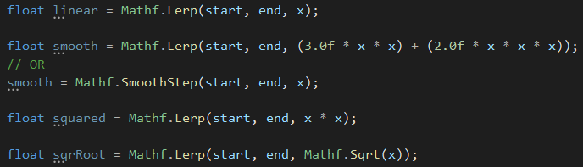
Smoothing Values Cont:
Lerp is great for interpolating between two values or points
If interpolating between two points:
Use Vector3.Lerp
Vector3.SmoothStep does not exist

Slide 9
2. UI
"How will the user interact with the application?"

Slide 10
UI Elements
Start Menu
First screen shown to the user
Start game at a specific difficulty
Pause Screen
Open and close with a key bind
Freeze game in background
HUD (Heads Up Display)
Health Bar
Level and score counters
Death Screen
Parameterized death message
Return to menu button

Slide 11
3. Interactables
"How will the player interact with my game?"

Slide 12
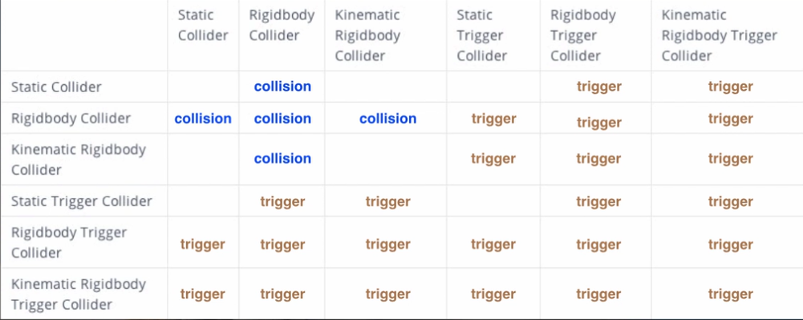
Interactables
Collisions
Unity Store Assets
Triggers vs Colliders
Prefabs

Slide 13
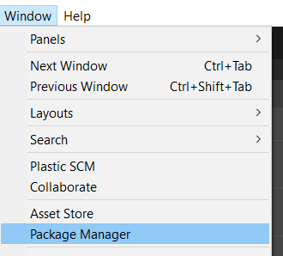
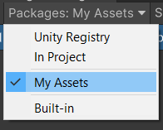


Unity Store
https://assetstore.unity.com
// Remember to log in!

Slide 14
4. Environment
"How will my game interact with the player?"

Slide 15
Environment
Resetting the Scene – Proceed to Next Level?
Adjust the Camera – Try to Keep Up!
Expanding the World – Creating Without Limits.

Slide 16
5. Export
"… OK, now how are people going to play it???"

Slide 17
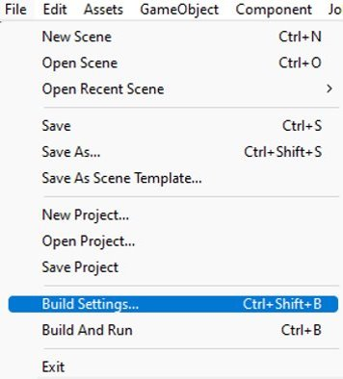
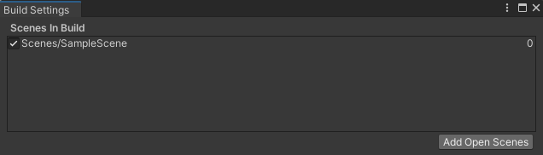
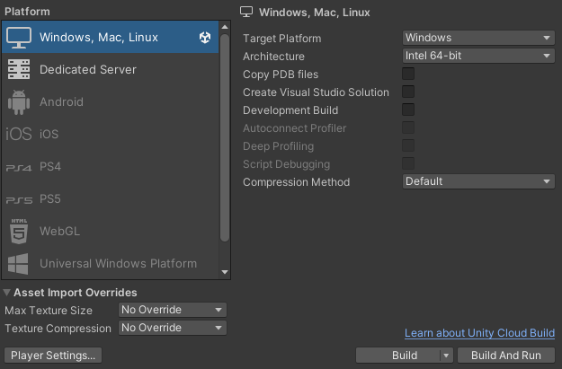
Build and Export Your Game
Open build settings
Use "Add Open Scene" to choose a Scene to export
Choose the desired platform to launch on
Select a directory to build the game in
If successful, game should run on completion
In the future, access the game by navigating to the application file of the same name!

Slide 18




You've done it!!
You've officially made
(or at least got a good idea of how to make)
a whole video game! Good job!!!
Good luck on your platformers!

